Slide 1
LQ: How do I revise in Year 11? Date:
1 | True or False? Organisation will help me to improve my GCSE grades.
2 | I am excited about __________________________ in Year 11.
3 | At Isca, we sit mocks in __________ and ___________
4 | My tutor group is _______
5 | One example of a revision strategy is ______________
Ext | True or False? I revised successfully for my Year 10 mocks

Slide 2
Review Now:
1 | True or False? Organisation will help me to improve my GCSE grades.
2 | I am excited about __________________________ in Year 11.
3 | At Isca, we sit mocks in November and March.
4 | My tutor group is _______
5 | One example of a revision strategy is flashcards/mindmapping/self – testing
Ext | True or False? I revised successfully for my Year 10 mocks

Slide 3
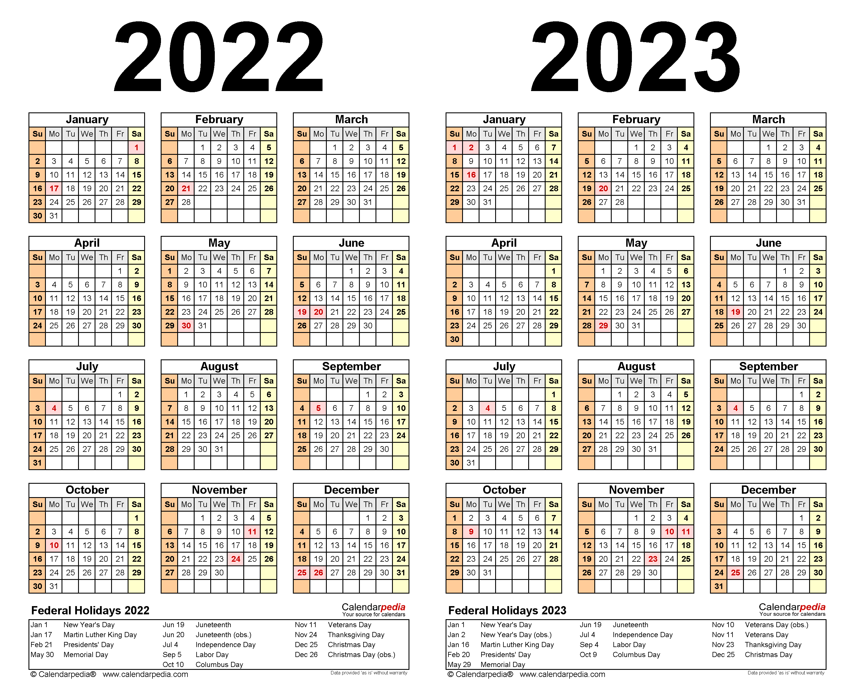
What does Year 11 look like?
November mocks
Mock results day
March mocks
GCSEs
Prom
Real results day

Slide 4
How do we support you in Year 11?
Subject specific tutor groups (Sept and Jan).
Homework/revision clubs (SPARX, quizlet etc.)
Exam lessons – essay writing English, exam paper maths.
Organisational support

Slide 5
Why is Revision Important?

Slide 6
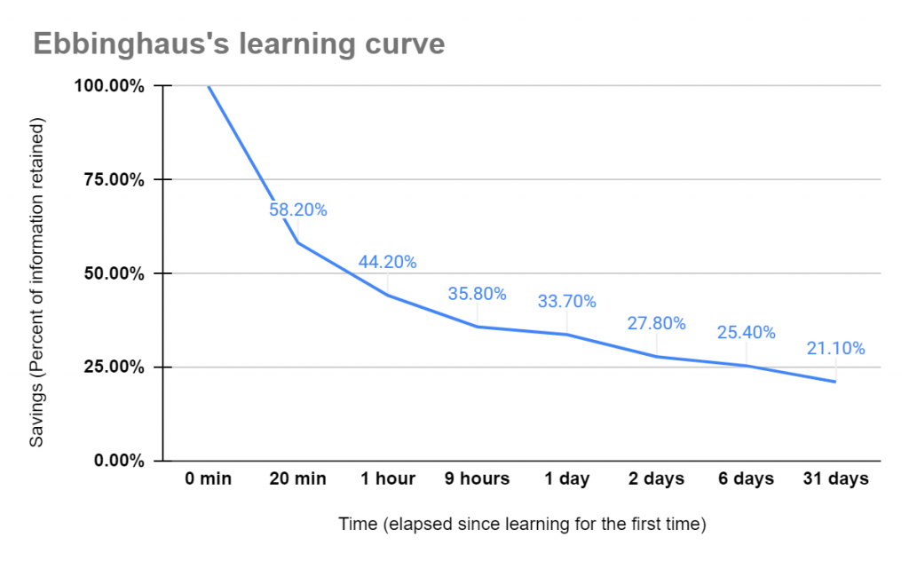
Key Concept: The Learning/Forgetting Curve
Forgetting is a key feature of learning.
Just 20 minutes after learning something, more than 40% of what you have learnt is lost.

Slide 7
Key Concept: The Learning/Forgetting Curve
A week after learning something, on average, you will only retain 25% of that information.

Slide 8
Advertisers know this:
How many times have you seen the same advert appear over and over again?
Research has found that the average consumer needs to see a piece of information at least 11 times before it’ll really sink in...
REVISION:

Slide 9
Key Concept: The Learning/Forgetting Curve
Regular and consistent revision of what you have learned will improve how much you will remember in preparation for your exams.

Slide 10
Where do I need to focus my revision: what should I revise?

Slide 11
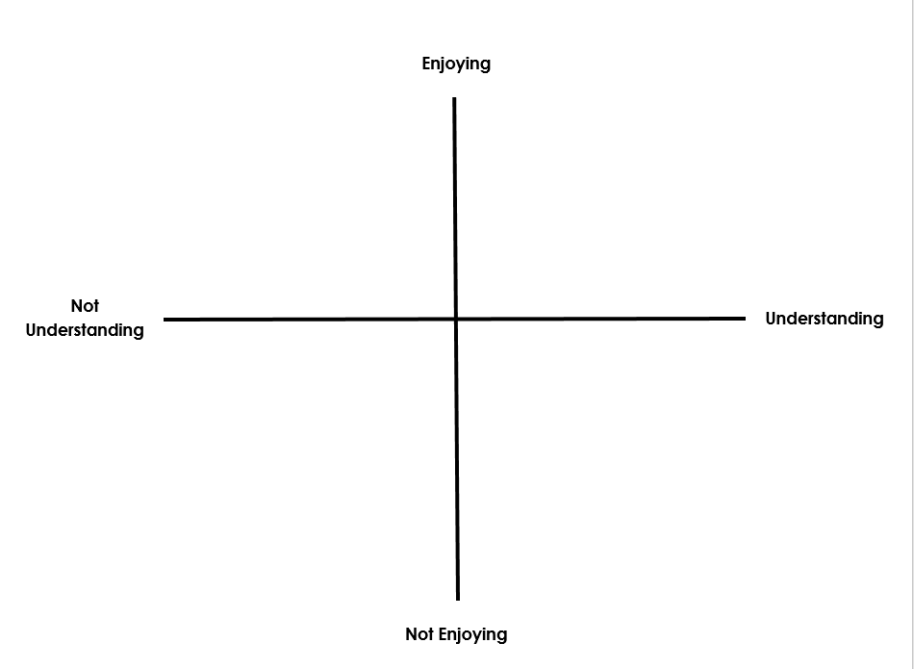
What should I revise?
Reflect back on Year 10 and place each of your subjects on the grid.
Once you’ve made your decisions and placed your subjects as dots or crosses on the grid, make notes under each dot explaining the reasons why you’ve positioned it there.

Slide 12
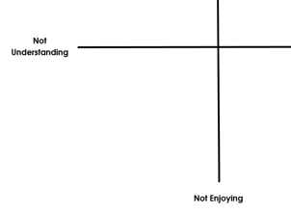
The Bottom Left
The bottom left is not going to go away!
By spending some time on them now, and disrupting the forgetting curve, you could avoid a real crisis later on in the year.

Slide 13
When should I revise?

Slide 14
Keys to Successful revision?
1. Organisational skills
2. Understanding how to revise
3. Stress management strategies

Slide 15
Be Honest With Yourself
Perhaps the most important aspect to successful revision is being honest with yourself. This may be the first time that you have had to sit down and organise your own study without anyone checking what you’re doing, and it is important to stress that it is no use telling yourself that you are revising if you are not. The only person this damages is you!

Slide 16
Have Lots of Options for Activities
Revision doesn’t just have to consist of sitting reading over your textbooks or notes. There are plenty of other activities that you can also do.
Practice exam questions
Flashcards
Mind Mapping
Quizlet/ Seneca/ Sparx/ Tassomai

Slide 17
Listen To, But Don’t Indulge, Yourself
Some days you can work for two hours solid, without a break. Other days you will be struggling to manage 20 minutes without being distracted.

Slide 18
Take a Break
If today just isn’t your day for revising, and you really can’t settle to anything, then take a break. But don’t just sit around looking at social media, or distracting your friends from their revision by messaging them.

Slide 19
The Importance of Exercise
You can be revising all day, and feel exhausted, but still be unable to sleep if you haven’t taken very much physical exercise all day.

Slide 20
Switching Off…
You need a chance to switch off before you try to sleep at the end of the day. Don’t stop revision and go straight to bed, but give yourself at least an hour in between.

Slide 21
...So be Organised
Plan your time!
Write a list of everything you need to do
Write down a time for each task (long or short)
Evaluate when you work best
Match up task with time
Make yourself a timetable
Form good habits

Slide 22
Task: Write down a list of everything to do (school related and non school related):
Weekly to do list:
1.) SPARX homework
2.) Flashcard revision
3.) Tassomai questions
4.) Knowledge organiser (every night!)
5.) Football training
6.) Quizlet
7.) Go out with friends
8.) Go for a run

Slide 23
Task: Write down time for each task on your list
Weekly to do list:
1.) SPARX homework (1 hour)
2.) Flashcard revision (45 mins)
3.) Tassomai questions (45 mins)
4.) Knowledge organiser(every night!) (30mins – 1 hour each night)
5.) Football training (1 hour Tuesday)
6.) Quizlet (1 hour)
7.) Go out with friends (2 hours)
8.) Go for a run (30mins)

Slide 24
Task: Analyse when you work best and match up time
Weekly to do list:
1.) SPARX homework (1 hour) Tuesday club (get help!)
2.) Flashcard revision (45 mins) Monday evening (5pm)
3.) Tassomai questions (45 mins) Sunday evening (6pm)
4.) Knowledge organiser(every night!) (30mins – 1 hour each night) 4pm each night – build routine!
5.) Football training (1 hour Tuesday)
6.) Quizlet (1 hour) Wednesday evening (5pm)
7.) Go out with friends (2 hours) Saturday afternoon 3pm
8.) Go for a run (30 mins) Tuesday and Thursday evening 5pm
Notes:
This is how to break it down. This then becomes habit!

Slide 25
Task: Use the revision timetable frame to plan your weekly activities, including revision.
TIME | MON | TUE | WED | THU | FRI | TIME | SAT | SUN
Notes:
This is how to break it down. This then becomes habit!

Slide 26
Example
TIME | MON | TUE | WED | THU | FRI | TIME | SAT | SUN
8.30-4pm | School | School | School | School | School | 9-10am | Breakfast | Breakfast
4pm-5pm | KO/ HW | KO/ HW | KO/ HW | KO /HW | KO /HW | 10-11am | Revision- English | Revision- Maths
5pm-6pm | Make Flashcards | Run | Quizlet | Run |  | 11am-1pm | Free time/ Lunch | Sport/ Lunch
6pm-7pm | Dinner | Dinner | Dinner | Dinner | Dinner | 1-3pm | Seeing Friends | Out with Family
7pm-8pm |  | Football |  |  |  | 3pm-5pm | Revision- Hums
8pm-9pm | Flashcard Revision | Football | Flashcard Revision | Flashcard Revision | Flashcard Revision | 6pm-9pm |  | Tassomai/ Free time
Notes:
This is how to break it down. This then becomes habit!

Slide 27
TIME | MON | TUE | WED | THU | FRI | TIME | SAT | SUN
Task: Use the revision timetable frame to plan your weekly activities, including revision.
Notes:
This is how to break it down. This then becomes habit!

Slide 28
Anticipating Challenges
Now you’ve got some essential tools to succeed:
A sense of which subjects are strengths and weaknesses (and where you should focus your revision accordingly)
A revision timetable to plan your schedule.
BUT
It’s also useful to think about the potential challenges that you might face this year...

Slide 29
Key Concept: If… Then…
Think about some potential challenges you might face this year and how you should respond to them...
If… my friends want to go out after school rather than stay for revision session | Then… I’ll arrange to meet them on the way home or later on.
If… | Then…
If… | Then…
If… | Then…
If… | Then…
Notes:
Ensure students are using their text trackers.
Model one first: If my friends want to go out after school rather than stay for a tutorial, then I’ll arrange to meet them on the way home.
If my phone goes off in the middle of revision…
.

Slide 30
Exit Ticket
Outside of lessons, a successful year 11 student will:
O_______________ their time well.
Focus their energy on improving subjects they do not u________________ or e_____________________.
Use a ________________ to have a clear and organised schedule.
Anticipate p_______________ and plan for how they will respond to them with maximum effort by using if… then….
Look after themselves by resting and eating well.

Slide 31
Exit Ticket
Outside of lessons, a successful year 11 student will:
Organise their time well.
Focus their energy on improving subjects they do not understand or enjoy.
Use a revision timetable to have a clear and organised schedule.
Anticipate problems and plan for how they will respond to them with maximum effort by using if… then….
Look after themselves by resting and eating well.

